Slide 1
Test Survey Summary

Slide 2
Summary
15 Respondents of 168 contacts
response rate <10%
Generally, the questions were comprehensible
There was some confusion as to what “amnesty” and “punishment” would like like, and respondents offered different visions of what this could look like
Jail time most common suggestion
“I am a Christian and will forgive, but these are bad men they have broken the law”
Cameroonians hold the belief Boko Haram had child soldiers. This could have influenced response rates on punishment.
Note that the majority of these respondents are farther from the violence, which changes the personal experience from that of Nigerians.

Slide 3
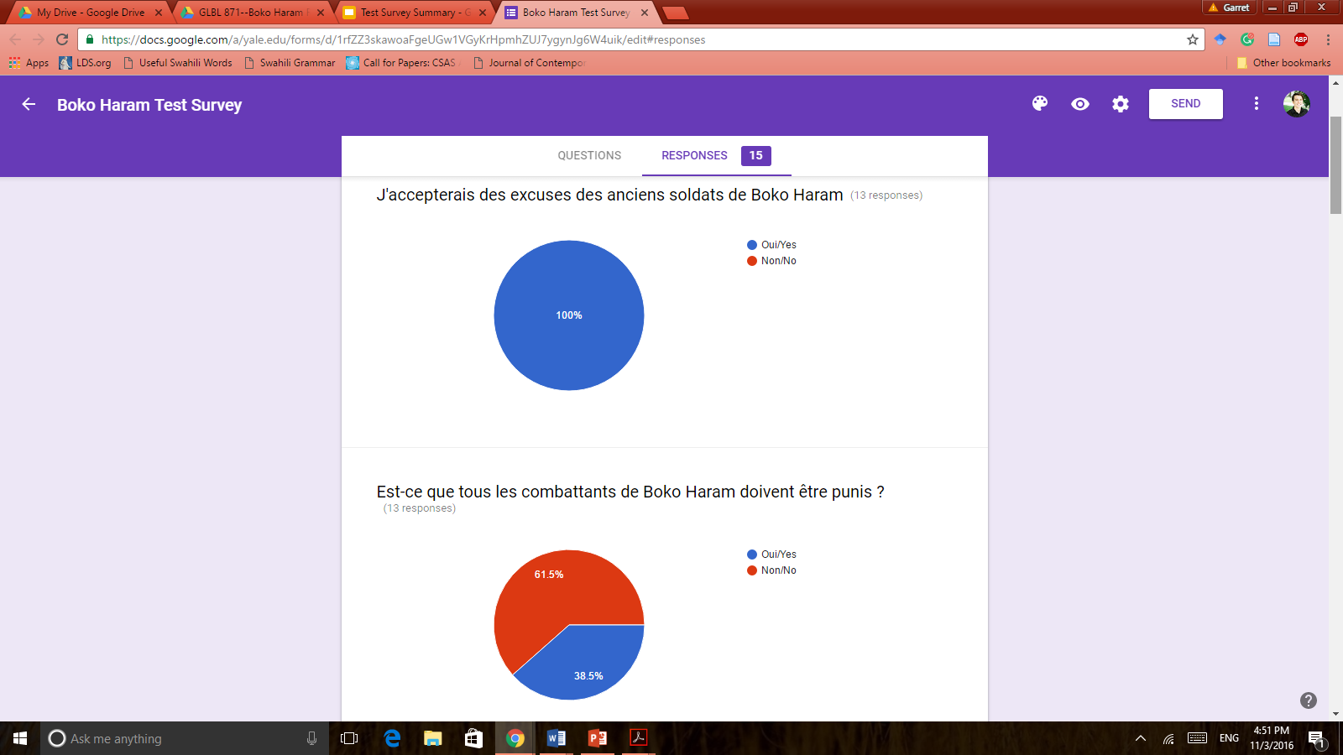
I would accept an apology from former Boko Haram Soldiers
Respondents made the distinction of “apology” from “forgiving” and “amnesty”. While they said they have no problem in accepting an apology, this does not preclude punishment or legal action against Boko Haram.

Slide 4
Should all Boko Haram insurgents be punished?
One respondent said “No” because she considered child soldiers. Her opinion changed when I specified adults who are primary actors in violence.

Slide 5
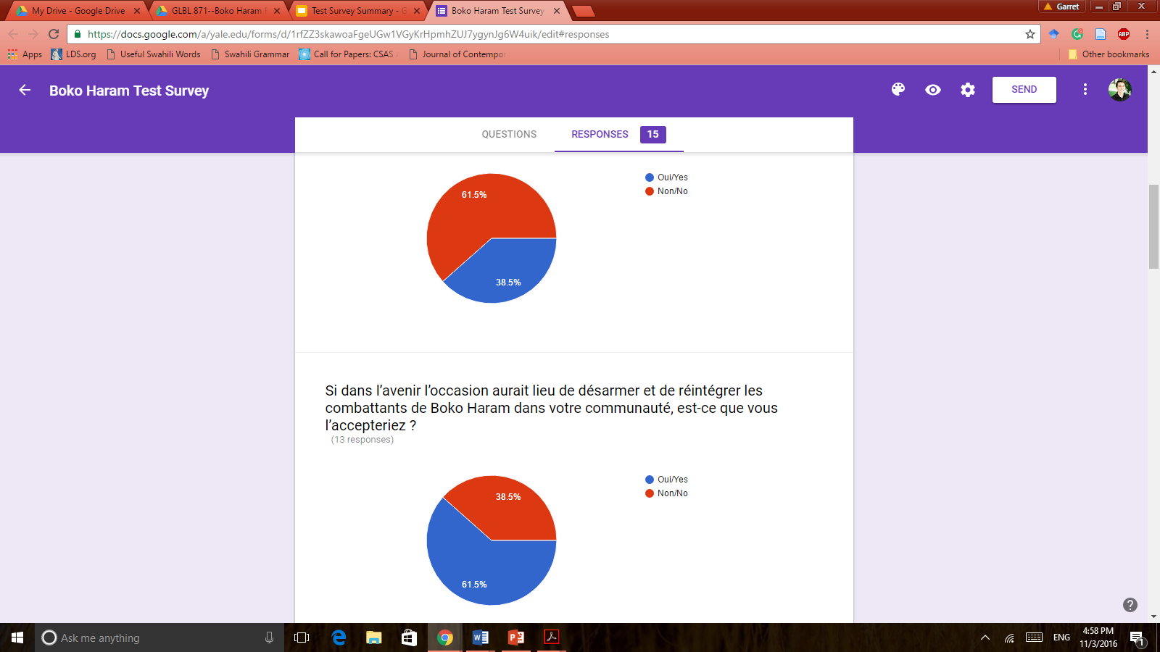
Should punishment be a condition for their return?
The answer was dependent on the perception of what “punishment” is and who was being punished (child soldier or adult)

Slide 6
If a future opportunity arose to disarm and reintegrate Boko Haram fighters into your community, would you welcome it?
Some respondents said yes if legal action against Boko Haram fighters had already taken place.

Slide 7
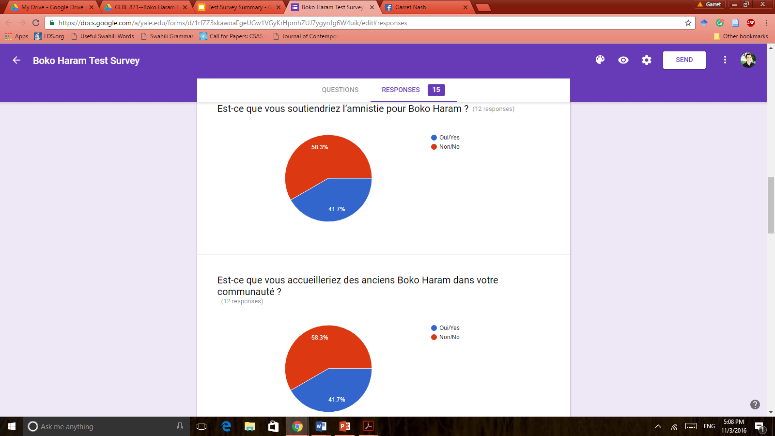
Would you support amnesty for Boko Haram?

Slide 8
Would you welcome former Boko Haram into your community?
Note that this is the exact same response numbers from the previous question. This suggests that amnesty and reintegration could be synonymous in the minds of respondents.

Slide 9
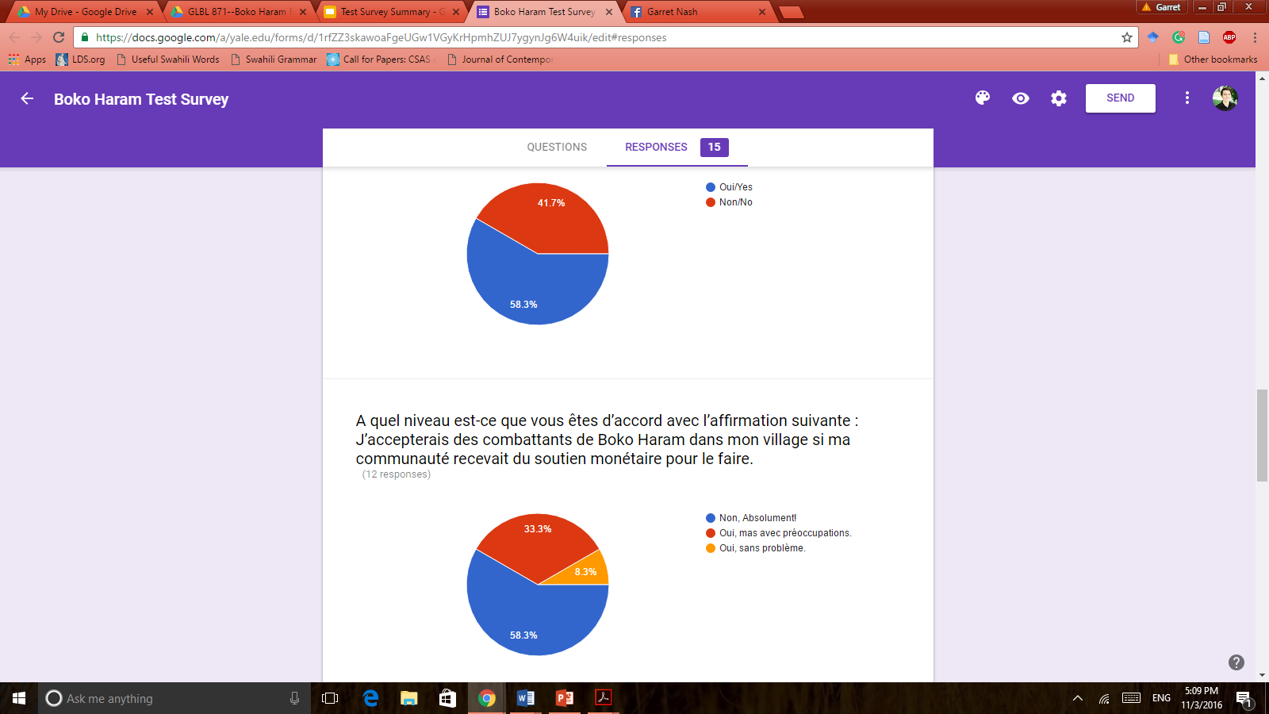
In addition to Boko Haram, do you believe that the Nigerian Military needs to be held accountable for its actions against civilians?

Slide 10
How strongly do you agree with the following statement: I would accept Boko Haram combatants back into my village, if my community received monetary support to do so.
Beforehand, we didn’t established the levels of agreement (so I made three up). What would those look like? Note that the second option (Yes, but with hesitation/preoccupation) was chosen more than option three (Yes, without problem)

Slide 11
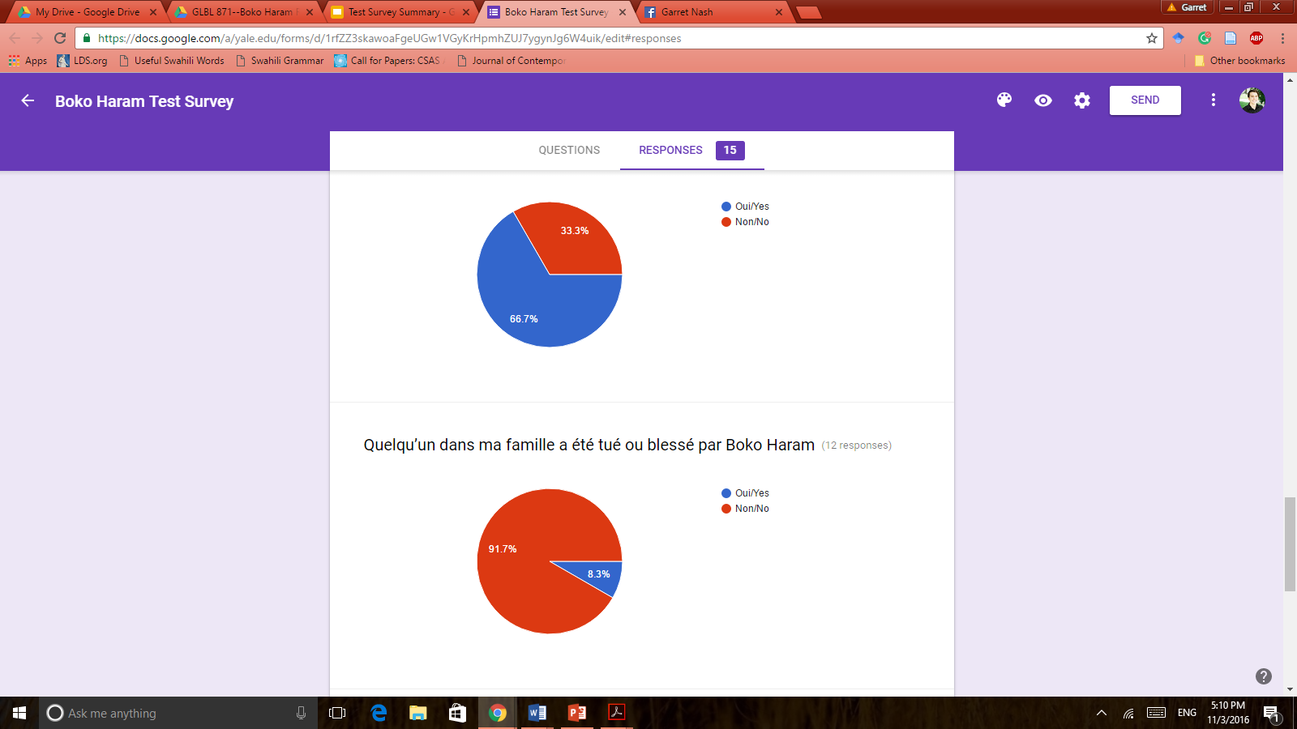
Do you agree or disagree- No Boko Haram fighter should be reintegrated into society until all the Chibok girls are returned.
First, I double-checked that Cameroonians knew who the Chibok girls are, which they did. Although they said their return is important, if an opportunity to end violence arose, that should be considered.

Slide 12
Someone in my family was killed or injured by Boko Haram.
This will obviously be different in Nigeria and as one gets closer to the violence. Most respondents are from the south of Cameroon, away from direct conflict.

